Slide 1

Team Name: AIgents
Team Members Details:
Domain/Technical Strengths: AI, ML & Deep Learning, Data Science & Visualization,
API Integration, Real-time Mapping, OpenAI, Google Maps API, Python , AWS
Contact details : ridajahan750@gmail.com
Name | College | Year
Rida Jahan | SRIST | 3rd
Jiya Sahu | SRIST | 3rd
Mansi Nigam | SRIST | 3rd
Priyansh Puri Goswami | SRIST | 3rd

Slide 2

Defining the Challenge: Urban Traffic & Pollution
Problem Statement
Brief Context
Unpredictable urban traffic leads to increased pollution and commuter delays.
• Causes health issues like asthma, stress, and fatigue • Wastes time and fuel, reducing daily productivity • Lack of real-time systems prevents quick response by authorities
Commuters – want faster, cleaner, safer routes.
City Planners – need data for smart infrastructure.
Environmental Agencies – manage pollution levels.
Transit Authorities – optimize routes and schedules with real-time data.
Target Users
Brief Context
Notes:
Idea Submissions Form – Details of the form Topic
Thesis Abstract Concept Note What is the solution Build? Business use case (Less than 100 – 200 words) Judge and filter becomes easy

Slide 3
1
3
2
CityPulse: AI-Based Solution
CityPulse predicts traffic and pollution in real-time to enable faster, healthier, and smarter urban mobility. An AI-driven system that helps users and city planners make smarter, greener decisions.
Key Features & Functionalities
Traffic Prediction (LSTM, Prophet), Pollution Forecast (real-time data), Smart Routing (AI logic), City Dashboard (heatmaps, alerts), Anomaly Detection (traffic/pollution spikes)
How AI is Used
Time-series forecasting (LSTM, Prophet), Regression models for pollution, Reinforcement learning for routing, Isolation Forest for anomaly detection
Notes:
Idea Submissions Form – Details of the form Topic
Thesis Abstract Concept Note What is the solution Build? Business use case (Less than 100 – 200 words) Judge and filter becomes easy

Slide 4
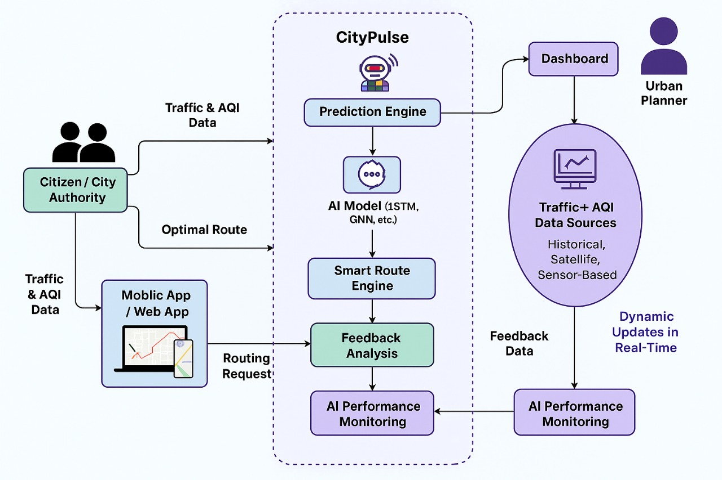
Technology Stack & Implementation Plan
System Architecture
Tech Stack
Frontend: HTML, CSS, JavaScript, React.js
Backend: Python
Frameworks: Flask or FastAPI
AI/ML: LSTM, Prophet, Regression, Reinforcement Learning, Isolation Forest
Frameworks: TensorFlow, scikit-learn, Prophet
Cloud & Hosting: AWS, Google Cloud Platform (GCP)
Real-time Data Sources Traffic: IoT Sensors, Mobile GPS, Traffic APIs, Traffic Cameras
Environmental: Satellite APIs
Dashboard & Visualization: Streamlit
Database: Firebase
APIs Used: OpenAI (for auto-response suggestions), Google Maps API (location tagging), Twilio (for SMS updates)
Short Development Plan
Set up GitHub repo, Flask structure, database, and OTP-based login. Implement complaint registration with Maps API, dashboards for users/admin, and status tracking. Integrate OpenAI for smart replies, Twilio/SMTP for updates, and refine UI for responsiveness. Test, debug, document, and deploy on AWS with demo preparation.
Notes:
Idea Submissions Form – Details of the form Topic
Thesis Abstract Concept Note What is the solution Build? Business use case (Less than 100 – 200 words) Judge and filter becomes easy

Slide 5
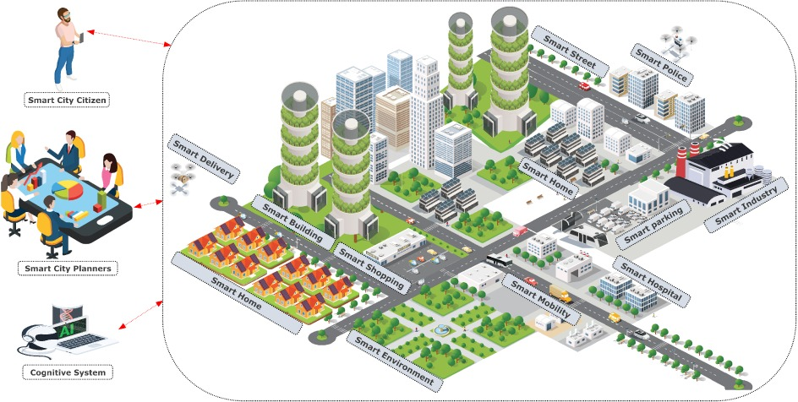
Impact & Future Scope
Expected Outcome / Value Created
Real-time intelligent route recommendations based on traffic + AQI data
Enhanced urban mobility and citizen health
Efficient data-driven urban planning
Reduction in fuel consumption and CO₂ emissions
Potential Social, Economic & Technological Impact
Social: Better air quality awareness & safer travel decisions
Economic: Reduced fuel costs, improved commuting efficiency
Technological: Promotes AI/ML in smart city infrastructure
Environmental: Decrease in pollution through smarter routing
Future Plans
Integration with government traffic management systems.Expansion to multiple cities with scalable APIs.Partnership with mobility & navigation services .AI Model improvement using larger datasets. Monetization through B2B urban planning tools
Notes:
Idea Submissions Form – Details of the form Topic
Thesis Abstract Concept Note What is the solution Build? Business use case (Less than 100 – 200 words) Judge and filter becomes easy

Slide 6
Thank You

